Slide 1
Time Zone Support in OpenUI5
Use cases, typical issues and best practices
Sven Bernhard, SAP SE
Viktor Sperling, SAP SE
July 6th, 2023

Slide 2
Agenda
Dates, times and timestamps
Implemented Features
What are the differences and how they are used in OData
DateTimeWithTimezone type, configurable time zone, UI5Date, best practices
Some use cases
Demos
Why do we need different time zones?
Time zone support in metadata driven and hand made applications
Q&A

Slide 3
Dates, times and timestamps

Slide 4
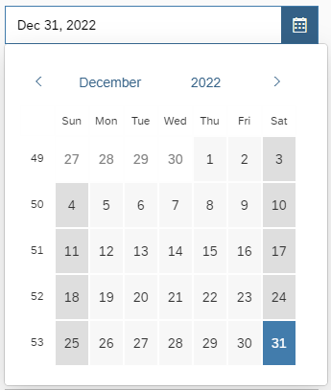
Dates, times and timestamps
A date is:
A day within a year
Independent of any time zone
Examples
New Year's Eve 2022 is on 2022/12/31, regardless of the time zone in which the user is in
Birthday

Slide 5
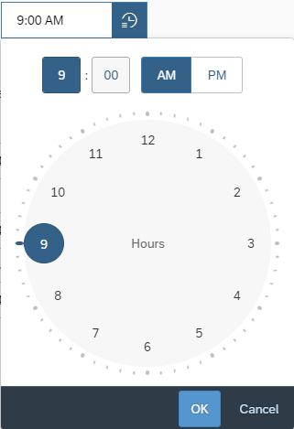
Dates, times and timestamps
A time is:
A specific hour/minute/second/millisecond within a day
Independent of any time zone
Examples
All shops of a brand open each day at 9:00 AM
I wake up every morning at 6:00 AM

Slide 6
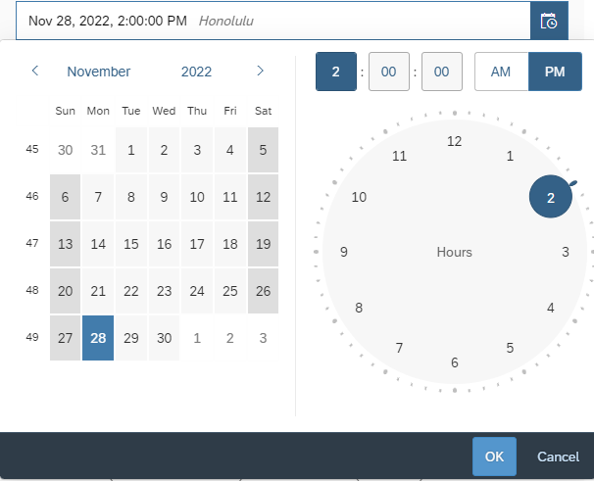
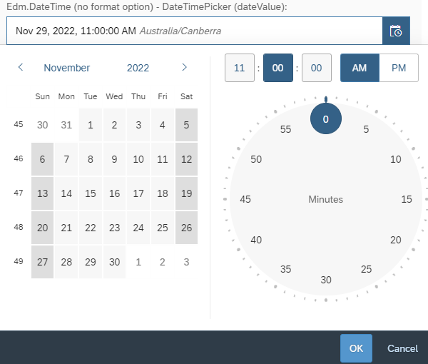
Dates, times and timestamps
A timestamp is:
A point in time
Can be displayed or edited in specific time zones
Examples
Schedule a meeting: Nov 28, 2022, 2:00:00 PM Honolulu Nov 29, 2022, 11:00:00 AM Australia/Canberra

Slide 7
Dates, times and timestamps in OData
OData V4
Values are transported and stored in the model as ISO strings:
Edm.Date: "2014-03-25"
Edm.TimeOfDay: "07:25:21.345"
Edm.DateTimeOffset: "2015-01-06T07:25:21Z" or "2015-01-06T07:25:21+02:00"
OData V2
Values are transported as strings and stored in the model as objects:
Edm.DateTime with sap:display-format="Date": "\/Date(1395752399000)\/" → JavaScript Date; use UTC getters to get day, month and year
Edm.Time: "PT11H33M55S" → { ms : 41635000, __edmType : 'Edm.Time’ }
Edm.DateTimeOffset: "\/Date(1420529121547+0000)\/" → JavaScript Date
Notes:
OData V2 Edm.DateTime and Edm.DateTimeOffset are transported in the same way
The resulting JavaScript Date objects have to be used differently
To get the day, month and year only the UTC getters have to be used for dates

Slide 8
Some use cases

Slide 9
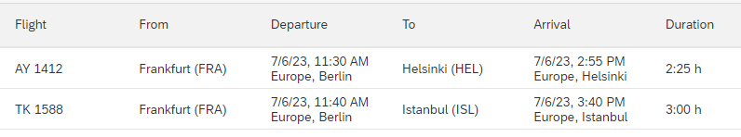
Some use cases
(I) As a user I want to see timestamps in any given time zone.
Schedule a meeting with people in different locations
Flights’ starting and landing timestamps in the local time zone of each airport
(II) As a user I want to see all timestamps in my configured time zone.
Monitor or plan a production chain
On a business trip I still want to see timestamps in my home location’s time zone

Slide 10
Implementation

Slide 11
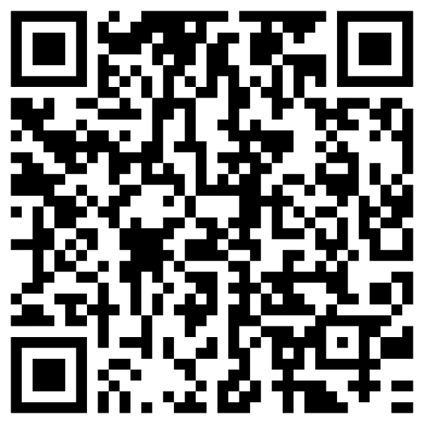
Use case (I): Timestamps in any given time zone
Get localized time zone names from CLDR
New date format instance (since 1.99): sap.ui.core.format.DateFormat#getDateTimeWithTimezoneInstance
Introduced composite type (since 1.99): sap.ui.model.odata.type.DateTimeWithTimezone
SmartField supports annotations:
References a time zone (since 1.100): com.sap.vocabularies.Common.v1.Timezone
Is IANA time zone ID (since 1.113): com.sap.vocabularies.Common.v1.IsTimezone
Notes:
DateFormat: (since 1.99)
Formats a JavaScript Date object in a given time zone
Parses a string into a JavaScript Date and an IANA time zone ID
Format options: showDate, showTime and showTimezone
DateTimeWithTimezone: (since 1.99)
Composite type with two parts: timestamp and IANA time zone ID
timestamp, e.g. a binding against an OData (V2 or V4) Edm.DateTimeOffset property
IANA time zone ID, e.g. “America/New_York”

Slide 12
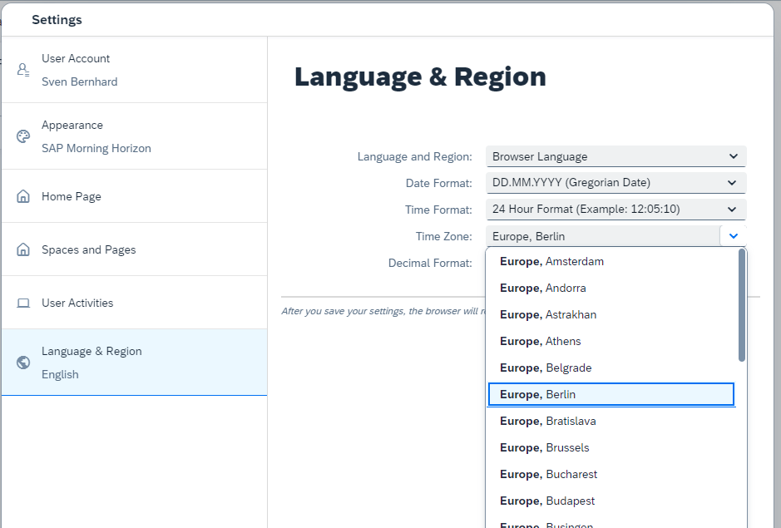

Use case (II): All timestamps in user’s time zone Step 1: The configuration
Configure the user’s time zone:
via sap-timezone URL parameter, e.g. sap-timezone=Pacific/Kiritimati
via API sap.ui.core.Configuration.setTimezone Don’t use the API in application code at runtime
via SAP Fiori Launchpad settings (if activated in the system)
Notes:
Use this API with care:
Changing the configuration affects all applications running with the current UI5 instance
It might cause inconsistencies if date objects have been created before

Slide 13
Use case (II): All timestamps in user’s time zone Step 2: Use a configured user time zone
sap.ui.core.format.DateFormat uses the configured time zone to format and parse timestamps if no other time zone is given
→ Some applications were broken if the configured time zone was different to the operating system’s time zone.
Symptom: Dates have been off by 1 day, e.g. Dec 31, 2022 instead of Jan 1, 2023
→ Deactivate the time zone configuration again to analyze the issues

Slide 14
Use case (II): All timestamps in user’s time zone Step 3: Analysis and typical issues
Timestamp shifting for Edm.DateTime properties annotated with sap:display-format="Date"
Usage of object based control properties like dateValue
OpenUI5 OData types have not been used
Usage of JavaScript Date’s local getters, setters, constructor and getTimezoneOffset
Most of these issues could be solved by using:
Bindings with the corresponding OpenUI5 OData type
The string based value property of e.g. the sap.m.DatePicker control
Notes:
Timestamp shifting:
The OData V2 value "\/Date(1672531200000)\/" is converted to a JavaScript Date Sun, 01 Jan 2023 00:00:00 GMT and represents Jan 1, 2023
The dateValue property of a DatePicker control expects that getDate(), getMonth() and getFullYear() of the given Date object return the day, month and year to be displayed
E.g. if I am located in San Francisco it would be Dec 31, 2022 as it is Sat Dec 31 2022 16:00:00 GMT-0800 (Pacific Standard Time)
So create another Date object by adding the date’s time zone offset * 60000 to get a Date object returning Jan 1, 2023 via getDate(), getMonth() and getFullYear()
Usage of JavaScript
JavaScript Date is not aware of the configured time zone

Slide 15
Use case (II): All timestamps in user’s time zone Step 4: JavaScript Date
Configured time zone === operating system’s time zone:
// constructor with parts in local time zone oDate = new Date(2023, 6, 6, 8, 15); oDate.getDate(); // → 6 oDate.getHours(); // → 8 DateFormat.getDateTimeInstance().format(oDate); // → 'Jul 6, 2023, 8:15:00 AM'
Configured time zone is America/Los_Angeles (GMT-07:00) and the operating system’s time zone is Europe/Berlin (GMT+02:00)
DateFormat.getDateTimeInstance().format(oDate); // → 'Jul 5, 2023, 11:15:00 PM'
→ API calls return different values than displayed on the UI

Slide 16
Use case (II): All timestamps in user’s time zone Step 5: Introduce sap.ui.core.date.UI5Date
Is a subclass of JavaScript Date
Behaves like a JavaScript Date
Considers the configured time zone in its local APIs:
oDate = UI5Date.getInstance(2023, 6, 6, 8, 15); oDate.getDate(); // → 6 oDate.getHours(); // → 8 DateFormat.getDateTimeInstance().format(oDate); // → 'Jul 6, 2023, 8:15:00 AM’
API calls are in sync with the visualization on the UI no matter which time zone is configured
→ Always use UI5Date.getInstance(…) instead of new Date(…)
Notes:
Behaves like a JavaScript Date
no additional enumerable properties
Object.prototype.toString.call(UI5Date.getInstance()) // → '[object Date]’
Why factory:
To use native dates whenever possible

Slide 17
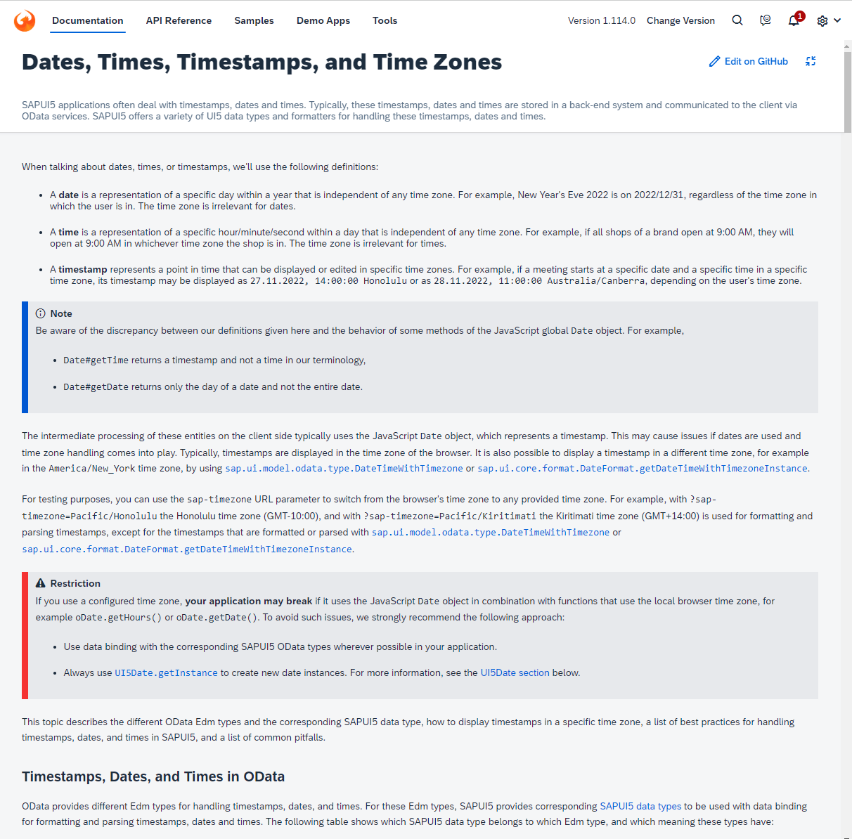

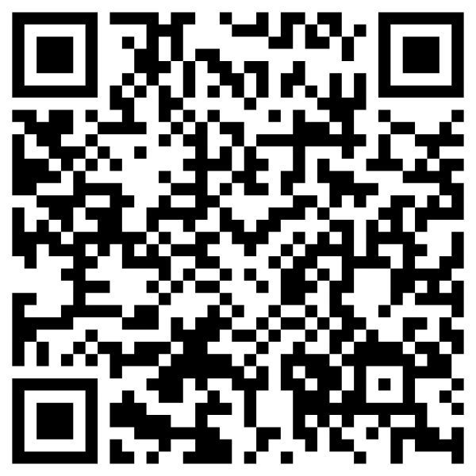
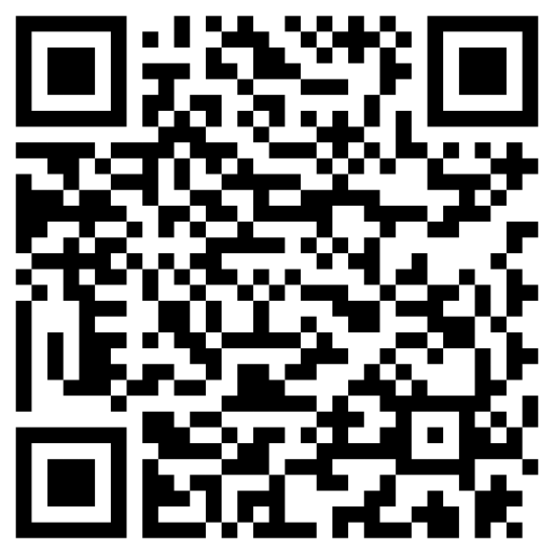
Use case (II): All timestamps in user’s time zone Step 6: Best practices
UI5ers live - YouTube
UI5 Demo Kit

Slide 18
Use case (II): All timestamps in user’s time zone Step 7: Consume best practices and re-activation
Use UI5Date instead of JavaScript Date in framework classes
Controls like DatePicker, TimePicker, DateTimePicker, DateRangeSelection or DynamicDateRange (all sap.m) use UI5Date
sap.m.DateTimePicker has new properties showTimezone and timezone
Role out best practices to applications
Most applications have been adjusted
Time zone configuration has been re-activated with version 1.114
Fiori Launch Page allows setting a user time zone
Notes:
Controls:
Use UI5 Date internally and externally (API)
Current date and time buttons consider the configured time zone

Slide 19
Use case (II): All timestamps in user’s time zone Step 8: Lessons learned
Using a configured time zone different to the operating system’s time zone may break applications that are using native JavaScript Date objects
→ Test applications with different time zones, for example Pacific/Kiritimati (GMT+14:00) and Pacific/Honolulu (GMT-10:00)
Use template based applications whenever possible
Use databinding with the corresponding OpenUI5 OData types even with JSON models
Use string based control properties for dates, times and timestamps
Replace new Date(…) by UI5Date.getInstance(…)

Slide 20
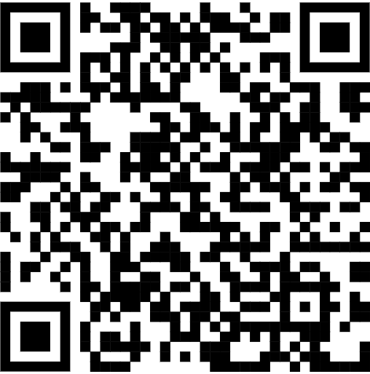
Demos

Slide 21
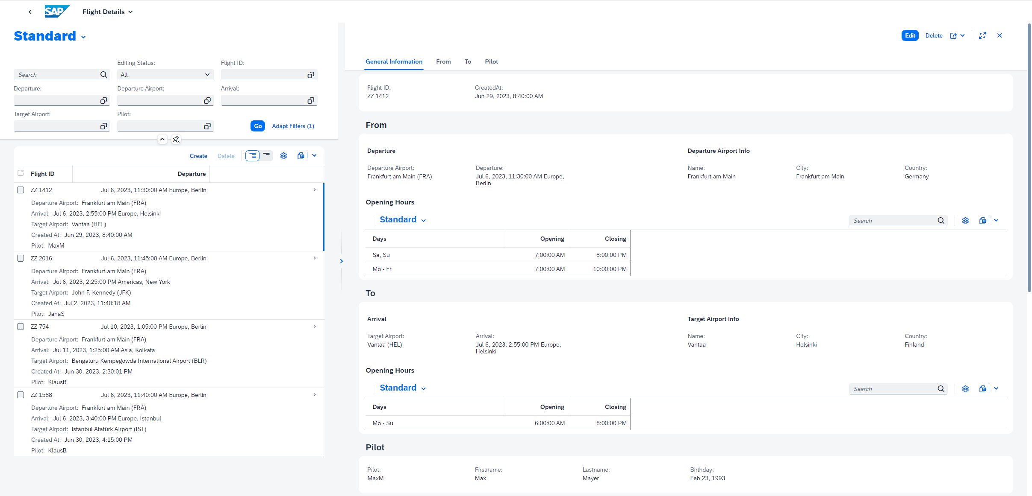
Demo 1: Metadata driven

Slide 22
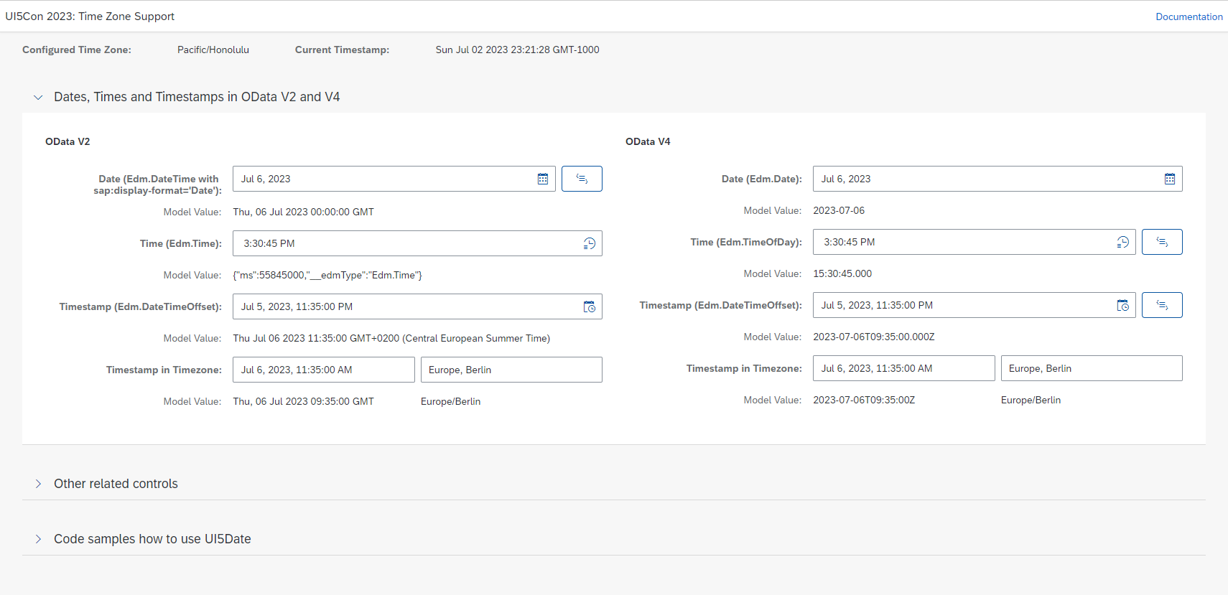
Demo 2: Freestyle application with code samples

Slide 23
Some links
SAPUI5 SDK: Dates, Times, Timestamps, and Time Zones
SmartField annotations
UI5ers Live: Dates, Times, Timestamps, and Time Zones
https://github.com/viktorsperling/UI5conDemo

Slide 24
Q&A

Slide 25
Thank you!
Sven, Bernhard
Viktor, Sperling
SAP SE
sven.bernhard@sap.com
SAP SE
viktor.sperling@sap.com

